Slide 1


Machine Learning LAB
Week 02

Slide 2
Lab Contents
I) Univariate Linear Regression
II) Multivariate Regression
2. Logistic Regression
3. Polynomial Regression
1. Linear Regression

Slide 3
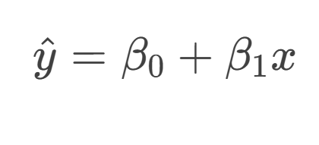
Univariate Linear Regression

Slide 4
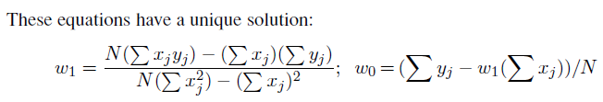
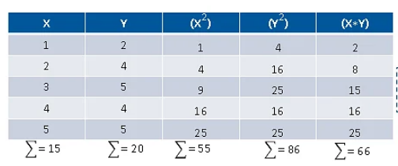
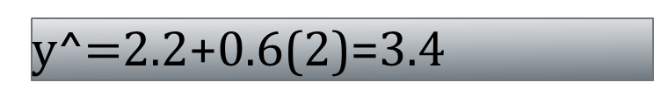
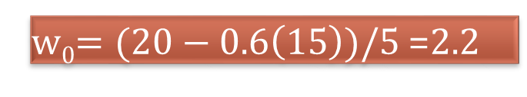
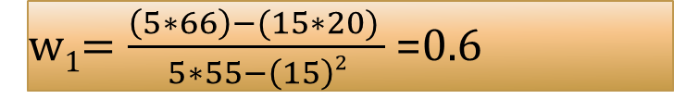
Solution
w₁$=\frac{\left(5∗66\right)−(15∗20) }{5∗55−\left(15\right)2}$ =0.6
w₀$=(20−0.6\left(15\right))/5$ =2.2
y^=2.2+0.6x
y^$=$2.2+0.6(2)=3.4

Slide 5
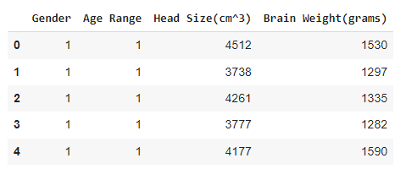
Load Dataset
import pandas as pd
df=pd.read_csv("/content/drive/My Drive/ML_Labs/DataSets/headbrain.csv")
df.head()

Slide 6
Load Dataset
# Computing X and Y
X = df['Head Size(cm^3)'].values
y = df['Brain Weight(grams)'].values

Slide 7

Calculate Parameters
import numpy as np
X_sum = np.sum(X)
X_squared_sum = np.sum(X * X)
n = len(X)
print("Sum of X:", X_sum)
print("Sum of X squared:", X_squared_sum)
print("Length of X:", n)

Slide 8

Estimate Parameters
import numpy as np
# Total number of values
n = len(X)
# calculating cross-deviation and deviation about x
numer=n*np.sum(X*y)-np.sum(X)*np.sum(y)
denom=n*np.sum(X*X)-(np.sum(X))**2
w1=numer/denom
# calculating regression coefficients
w0=(np.sum(y)-w1*(np.sum(X)))/n
w1,w0

Slide 9
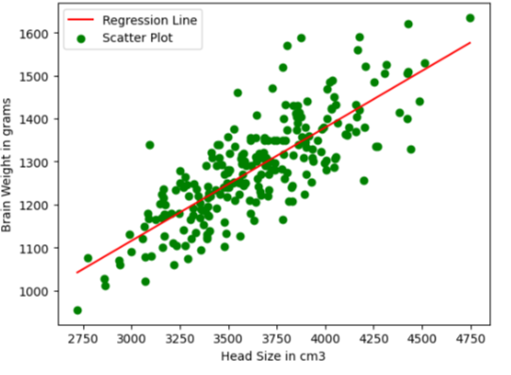
Plot Regression Line
import matplotlib.pyplot as plt
max_x = np.max(X)
min_x = np.min(X)
# Calculating line values x and y
x1 = np.linspace(min_x, max_x)
y1 = w0 + w1 * x1
# Ploting Line
plt.plot(x1, y1, color='red', label='Regression Line')
# Ploting Scatter Points
plt.scatter(X, y, c='green', label='Scatter Plot')
plt.xlabel('Head Size in cm3')
plt.ylabel('Brain Weight in grams')
plt.legend()
plt.show()

Slide 10
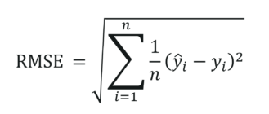

Calculate RMSE
# Calculating Root Mean Squares Error
rmse = 0
for i in range(n):
y_pred = w0 + w1 * X[i]
rmse += (y[i] - y_pred) ** 2
rmse = np.sqrt(rmse/n)
print("RMSE=",rmse)

Slide 11
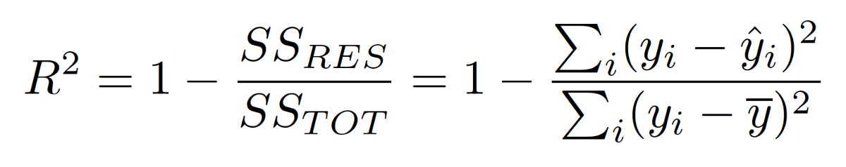

Calculating R2 Score
ss_tot = 0
ss_res = 0
y_mean=np.mean(y)
for i in range(n):
y_pred = w0 + w1 * X[i]
ss_tot += (y[i] -y_mean ) ** 2
ss_res += (y[i] - y_pred) ** 2
r2 = 1 - (ss_res/ss_tot)
print("R2 Score=",r2)

Slide 12

MULTIVARIATE LINEAR REGRESSION
Real world problems rarely depend on just one input. Multivariate Linear Regression extends the same idea to many input variables at once

Slide 13
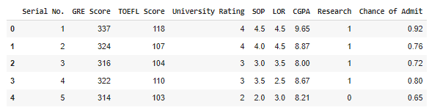
MULTIVARIATE LINEAR REGRESSION
import pandas as pd
df=pd.read_csv("/content/Admission_Predict.csv")
coulumns=df.columns
df.drop("Serial#",axis=1,inplace=True)
y = df['Chance of Admit']
df.drop("Chance of Admit",axis=1,inplace=True)
df.head()

Slide 14
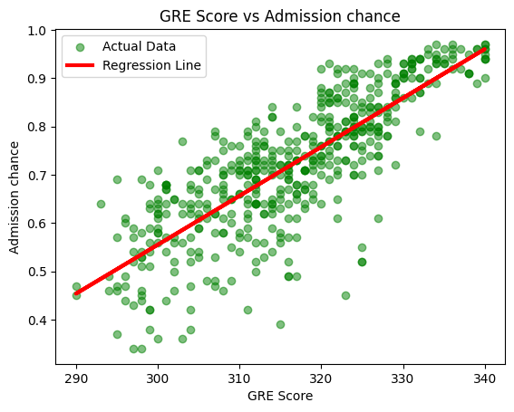
MULTIVARIATE LINEAR REGRESSION
import matplotlib.pyplot as plt
from sklearn.linear_model import LinearRegression
# Initialize and train the linear regression model
simple_lr = LinearRegression()
simple_lr.fit(df[['GRE Score']], y)
plt.scatter(df['GRE Score'], y, color='green', label='Actual Data', alpha=0.5)
plt.plot(df['GRE Score'], simple_lr.predict(df[['GRE Score']]), color='red', linewidth=3, label='Regression Line')
plt.xlabel('GRE Score')
plt.ylabel('Admission chance')
plt.title('GRE Score vs Admission chance')
plt.legend()
plt.show()

Slide 15
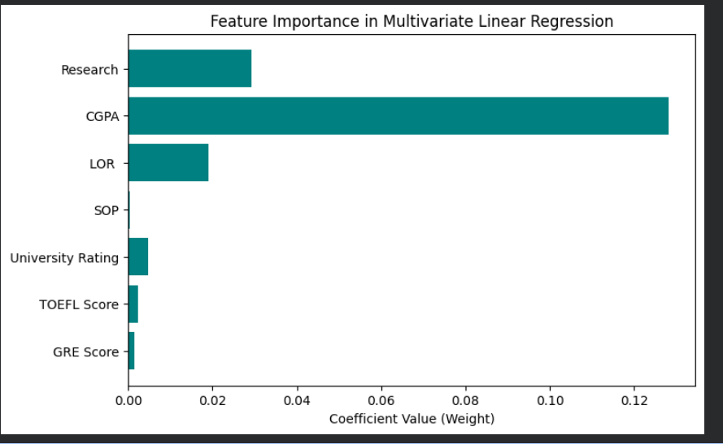
MULTIVARIATE LINEAR REGRESSION
import matplotlib.pyplot as plt
from sklearn.linear_model import LinearRegression
# Instantiate and train a multivariate linear regression model
lr = LinearRegression()
lr.fit(x_train, y_train)
coefficients = lr.coef_
features = df.columns
plt.figure(figsize=(8, 5))
plt.barh(features, coefficients, color='teal')
plt.xlabel('Coefficient Value (Weight)')
plt.title('Feature Importance in Multivariate Linear Regression')
plt.axvline(x=0, color='black', linewidth=0.8)
plt.show()

Slide 16

MULTIVARIATE LINEAR REGRESSION
from sklearn import metrics
import numpy as np
from sklearn.model_selection import train_test_split
x_train, x_test, y_train, y_test = train_test_split(df, y, test_size=0.2)
rmse = np.sqrt(metrics.mean_squared_error(y_test, pred))
print("RMSE:", rmse)

Slide 17
Logistic Regression (Scratch)
Logistic regression is a statistical and machine learning technique used for classification problems, where the goal is to predict a categorical outcome, most commonly a binary outcome (yes/no, 0/1, pass/fail), based on one or more independent variables
linear regression predicts values with a straight line, while logistic regression predicts categories, and the output curve is not straight, it is S shaped, passes it through a special function called the sigmoid function, which converts any number into a probability range of 0-1.

Slide 18
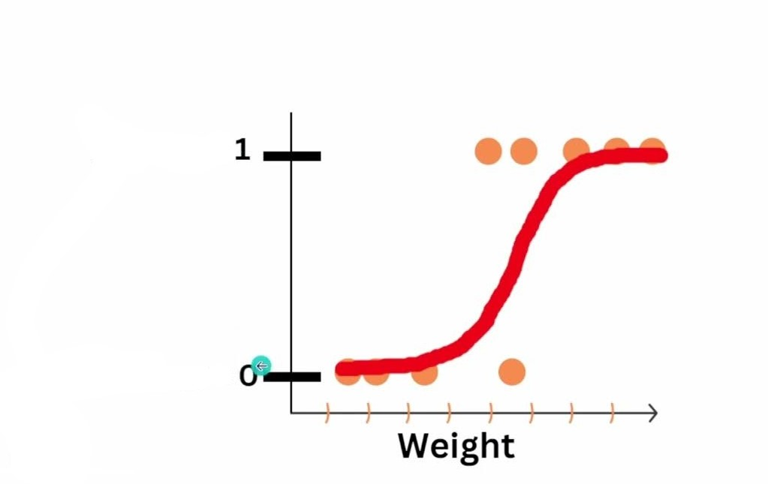
Logistic Regression (Scratch)
in linear relation we can draw straight line to classify but in this we can’t.
The outcome is form of s.
Backend working sigmoid or logit function
Sigmoid probability is equal to 1 / 1 + e^{-z}. So e Euler's number = 2.7
Z is equal to linear equation equation y= Mx+b...
it converts input into 0 1 range...

Slide 19
Logistic Regression (Scratch)
import numpy as np
import pandas as pd
from sklearn.model_selection import train_test_split
from sklearn.preprocessing import StandardScaler, LabelEncoder
from sklearn.metrics import accuracy_score, classification_report, confusion_matrix
# Load the dataset from a CSV file
data = pd.read_csv('/content/Social_Network_Ads.csv')

Slide 20
Logistic Regression (Scratch)
# Preprocessing
# Encode categorical variable 'Gender'
labelencoder = LabelEncoder()
data['Gender'] = labelencoder.fit_transform(data['Gender']) # Male=1, Female=0
# Define features and target variable
X = data[['Gender', 'Age', 'EstimatedSalary']].values # Select relevant columns
y = data['Purchased'].values # Target variable

Slide 21
Logistic Regression (Scratch)
# Split the dataset into training and testing sets
X_train, X_test, y_train, y_test = train_test_split(X, y, test_size=0.2, random_state=42)
# Scale the features
scaler = StandardScaler()
X_train = scaler.fit_transform(X_train)
X_test = scaler.transform(X_test)

Slide 22
Logistic Regression (Scratch)
# Logistic Regression Implementation
class LogisticRegression:
def __init__(self, learning_rate=0.01, num_iterations=1000):
self.lr = learning_rate
self.iterations = num_iterations
self.weights = None
self.bias = None
def sigmoid(self, z):
return 1 / (1 + np.exp(-z))
def fit(self, X, y):
num_samples, num_features = X.shape
self.weights = np.zeros(num_features)
self.bias = 0

Slide 23
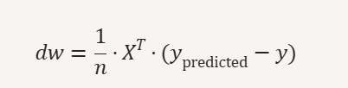
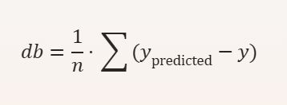
Logistic Regression (Scratch)
for i in range(self.iterations):
linear_model = np.dot(X, self.weights) + self.bias
y_predicted = self.sigmoid(linear_model)
# Update weights and bias by calculating Gradient
dw = (1 / num_samples) * np.dot(X.T, (y_predicted - y))
db = (1 / num_samples) * np.sum(y_predicted - y)
self.weights -= self.lr * dw
self.bias -= self.lr * db
def predict(self, X):
linear_model = np.dot(X, self.weights) + self.bias
return [1 if i > 0.5 else 0 for i in self.sigmoid(linear_model)]

Slide 24
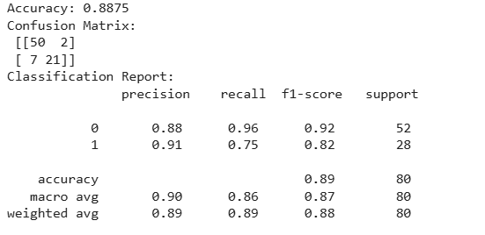
Logistic Regression (Scratch)
# Train the Model
model = LogisticRegression(learning_rate=0.1, num_iterations=1000)
model.fit(X_train, y_train)
# Evaluate the Model
predictions = model.predict(X_test)
print("Accuracy:", accuracy_score(y_test, predictions))
print("Confusion Matrix:\n", confusion_matrix(y_test, predictions))
print("Classification Report:\n", classification_report(y_test, predictions))

Slide 25
Logistic Regression (Sklearn)
import pandas as pd
from sklearn.model_selection import train_test_split
from sklearn.preprocessing import StandardScaler, LabelEncoder
from sklearn.linear_model import LogisticRegression
from sklearn.metrics import accuracy_score, confusion_matrix, classification_report
# Load dataset
data = pd.read_csv("/content/Social_Network_Ads.csv")
# Encode Gender (Male/Female → 1/0)
le = LabelEncoder()
data['Gender'] = le.fit_transform(data['Gender'])

Slide 26
Logistic Regression (Sklearn)
# Features & target
X = data[['Gender', 'Age', 'EstimatedSalary']].values
y = data['Purchased'].values
# Train-test split
X_train, X_test, y_train, y_test = train_test_split(X, y, test_size=0.2, random_state=42)
# Scale features
scaler = StandardScaler()
X_train = scaler.fit_transform(X_train)
X_test = scaler.transform(X_test)

Slide 27
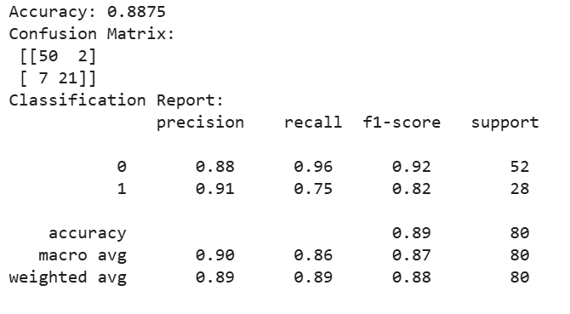
Logistic Regression (Sklearn)
# Logistic Regression
model = LogisticRegression()
model.fit(X_train, y_train)
# Predictions
y_pred = model.predict(X_test)
# Evaluation
print("Accuracy:", accuracy_score(y_test, y_pred))
print("Confusion Matrix:\n", confusion_matrix(y_test, y_pred))
print("Classification Report:\n", classification_report(y_test, y_pred))

Slide 28
Polynomial regression
Polynomial regression fits a curved line instead of a straight line by adding powers of x (x², x³, etc.) as extra features. It still uses the same linear regression method underneath, just applied to these transformed features, so it can capture non-linear patterns in data.

Slide 29
Polynomial Regression
import pandas as pd
import numpy as np
import matplotlib.pyplot as plt
from sklearn.linear_model import LinearRegression
from sklearn.preprocessing import PolynomialFeatures
# Load dataset
data = pd.read_csv("Position_Salaries.csv")
# Independent variable (Level) and dependent variable (Salary)
X = data[["Level"]].values
y = data["Salary"].values

Slide 30
Polynomial Regression
# Polynomial transformation (degree=4 for better curve fitting)
poly = PolynomialFeatures(degree=4)
X_poly = poly.fit_transform(X)
# Train polynomial regression model
poly_model = LinearRegression()
poly_model.fit(X_poly, y)
# Predictions
y_pred = poly_model.predict(X_poly)

Slide 31
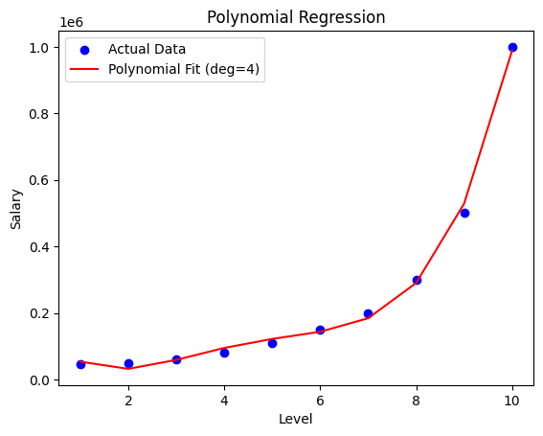
Draw the line….
# Plot results
plt.scatter(X, y, color="blue", label="Actual Data")
plt.plot(X, y_pred, color="red", label="Polynomial Fit (deg=4)")
plt.xlabel("Level")
plt.ylabel("Salary")
plt.title("Polynomial Regression")
plt.legend()
plt.show()
Find out its R2 score and RMSE

Slide 32
Activity 1
Predict a person’s medical insurance cost based on their personal details.
Dataset: Medical Cost Personal Dataset
Instructions
Load and explore the dataset.
  Features include: age, bmi, children, smoker, region.
  Target = charges (insurance cost).
Preprocess:
  Apply Encoding to categorical features (region, smoker).
  Scale numerical features.
Train a Linear Regression model to predict charges.
Evaluate using RMSE & R² score.
Plot Predicted vs Actual Costs.

Slide 33
Activity 2
Predict whether a customer will churn (leave the company) based on their behavior and usage patterns.
Dataset: Telco Customer Churn
Instructions:
Load dataset and preprocess categorical variables ( Encoding).
Train a Logistic Regression model with features like tenure, MonthlyCharges, Contract, InternetService.
Evaluate using Accuracy, Precision, Recall, F1-score.
Plot Confusion Matrix & ROC Curve.

Slide 34
Activity 3
Predict used car prices based on mileage, age, and horsepower.
Dataset: Car Price Prediction
Instructions:
Choose features like Kms_Driven, Year, Engine, Horsepower.
Apply Linear Regression and record performance.
Apply Polynomial Regression (degree=2,3,4) and compare results.
Plot fitted curves for different polynomial degrees.

